Slide 1
18-447 Computer Architecture Lecture 33: Interconnection Networks
Prof. Onur Mutlu
Carnegie Mellon University
Spring 2015, 4/27/2015

Slide 2
Logistics
Lab 7 and Lab 8
Final Exam
Midterm II scores
Course grades so far
Course evaluations
740 next semester
Plans for Wed and Fri lectures

Slide 3
Lab 6 Extra Credit
2.5% Ashish Shrestha (ashresth)
2.5% Amanda Marano (amarano)
2.5% Pete Ehrett (wpe)
2.0% Jared Choi (jaewonch)
2.0% Akshai Subramanian (avsubram)
2.0% Sohil Shah (sohils)
2.0% Raghav Gupta (raghavg)
1.5% Kais Kudrolli (kkudroll)

Slide 4
Lab 7
Abstract, cycle-level modeling of the memory hierarchy
L2 Cache and Main Memory Controllers
A key part of all modern computing systems today
You can submit until May 1 and still get full credit
Feel free to submit the Extra Credit portion as well
Prefetching
You can get up to 2% of course grade as extra credit
Remember: The goal is for you to learn…

Slide 5
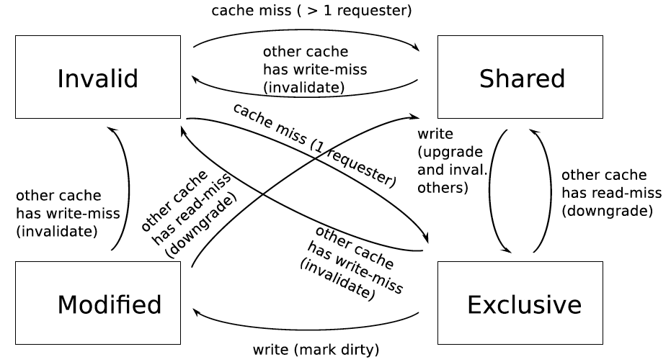
Extra Credit Lab 8: Multi-Core Cache Coherence
Completely extra credit (all get 5% for free; can get 5% more)
Last submission accepted on May 10, 11:59pm; no late submissions
Cycle-level modeling of the MESI cache coherence protocol

Slide 6
Midterm 2 Grade Distribution
AVG = 152
Median = 154
STDDEV = 37
Max = 240
Min = 61

Slide 7
Midterm 2 Grade Distribution (%)
AVG = 45
Median = 45
STDDEV = 40
Max = 71
Min = 18

Slide 8
Final Exam: May 5
May 5, 5:30-8:30pm, Location: BH A51
Comprehensive (over all topics in course)
Three cheat sheets allowed
We will (likely) have a review session on Friday
Remember this is 22% of your grade
I will take into account your improvement over the course
Know all concepts, especially the previous midterm concepts
Same advice as before for Midterms I and II

Slide 9
Course Grades So Far
AVG = 57
Median = 58
STDDEV = 6.5
Max = 66
Min = 43
Max_possible = 71
Max_possible + EC = 87.15
Notes:
I will guarantee at least the following grades:
A: 90-100
B: 80-90
C: 70-80
D: 60-70
R: 0-60
I may lower the lowest point of a grade range, but not raise them.

Slide 10
A Note on 740, Research, Jobs/Internships
I am teaching 740 next semester (Fall 2015)
Lectures M, W 7:30-9:20pm
Recitations T 7:30-9:20pm
If you are enjoying 447 and are doing well, you can take it
→ feel free to talk with me
If you are excited about Computer Architecture research or looking for a job/internship in this area
→ talk with me

Slide 11
More on 740
740 is the next course in sequence
Time: Lect. MW 7:30-9:20pm, Rect. T 7:30-9:20pm
Content:
Lectures: More advanced, with a different perspective
Recitations: Delving deeper into papers, advanced topics
Readings: Many fundamental and research readings; will do many reviews
Project: More open ended research project. Proposal → milestones → final poster and presentation
Done in groups of 1-3
Focus of the course is the project and critical reviews of readings
Exams: lighter and fewer
Homeworks: None

Slide 12
Course Evaluations (due May 11)
Due May 11, 11:59pm
Please do not forget to fill out the course evaluations
http://www.cmu.edu/hub/fce/
Your feedback is very important
I read these very carefully, and take into account every piece of feedback
And, improve the course for the future
Please take the time to write out feedback
State the things you liked, topics you enjoyed, what you think the course contributed to your learning, what we can improve on
Please don’t just say “the course is hard and fast paced”
Because you knew that from the very beginning!

Slide 13
Extra Credit for Course Evaluations
0.25% extra credit for everyone in the class if more than 90% (i.e., 25) of you fill out the evaluations

Slide 14
Plan for Wed and Fri Sessions This Week
Wednesday: Informal Q&A Session
Location: Porch
Tentative format: Fun, information, food
Come with questions (about comp arch/systems, and anything else)
We will have food
Friday: Final Exam Review
Location: HH 1107
Tentative format: TAs will go over Midterms I and II and answer your questions

Slide 15
Where We Are in Lecture Schedule
The memory hierarchy
Caches, caches, more caches
Virtualizing the memory hierarchy: Virtual Memory
Main memory: DRAM
Main memory control, scheduling
Memory latency tolerance techniques
Non-volatile memory
Multiprocessors
Coherence and consistency
In-memory computation and predictable performance
Multi-core issues (e.g., heterogeneous multi-core)
Interconnection networks

Slide 16
Interconnection Network Basics

Slide 17
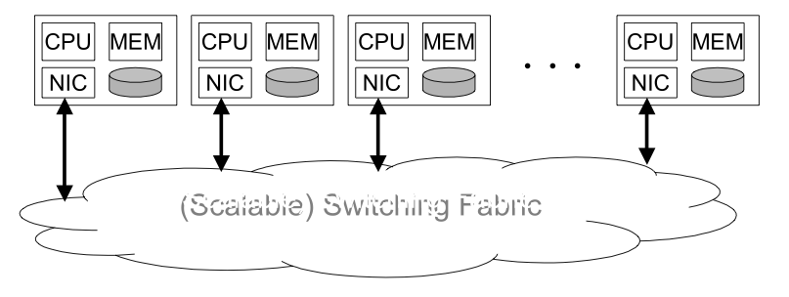
Where Is Interconnect Used?
To connect components
Many examples
Processors and processors
Processors and memories (banks)
Processors and caches (banks)
Caches and caches
I/O devices
Interconnection network

Slide 18
Why Is It Important?
Affects the scalability of the system
How large of a system can you build?
How easily can you add more processors?
Affects performance and energy efficiency
How fast can processors, caches, and memory communicate?
How long are the latencies to memory?
How much energy is spent on communication?

Slide 19
Interconnection Network Basics
Topology
Specifies the way switches are wired
Affects routing, reliability, throughput, latency, building ease
Routing (algorithm)
How does a message get from source to destination
Static or adaptive
Buffering and Flow Control
What do we store within the network?
Entire packets, parts of packets, etc?
How do we throttle during oversubscription?
Tightly coupled with routing strategy

Slide 20
Topology
Bus (simplest)
Point-to-point connections (ideal and most costly)
Crossbar (less costly)
Ring
Tree
Omega
Hypercube
Mesh
Torus
Butterfly
…

Slide 21
Metrics to Evaluate Interconnect Topology
Cost
Latency (in hops, in nanoseconds)
Contention
Many others exist you should think about
Energy
Bandwidth
Overall system performance

Slide 22
Bus
All nodes connected to a single link
+ Simple + Cost effective for a small number of nodes
+ Easy to implement coherence (snooping and serialization)
- Not scalable to large number of nodes (limited bandwidth, electrical loading → reduced frequency)
- High contention → fast saturation
0
1
2
3
4
5
6
7

Slide 23
Point-to-Point
0
Every node connected to every other
with direct/isolated links
+ Lowest contention
+ Potentially lowest latency
+ Ideal, if cost is no issue
-- Highest cost
O(N) connections/ports
per node
O(N²) links
-- Not scalable
-- How to lay out on chip?
7
1
6
2
5
3
4

Slide 24
Crossbar
Every node connected to every other with a shared link for each destination
Enables concurrent transfers to non-conflicting destinations
Could be cost-effective for small number of nodes
+ Low latency and high throughput
- Expensive
- Not scalable → O(N²) cost
- Difficult to arbitrate as N increases
Used in core-to-cache-bank
networks in
- IBM POWER5
- Sun Niagara I/II
7
6
5
4
3
2
1
0
0
1
2
3
4
5
6
7

Slide 25
Another Crossbar Design
0
1
2
3
4
5
6
7
0
1
2
3
4
5
6
7

Slide 26
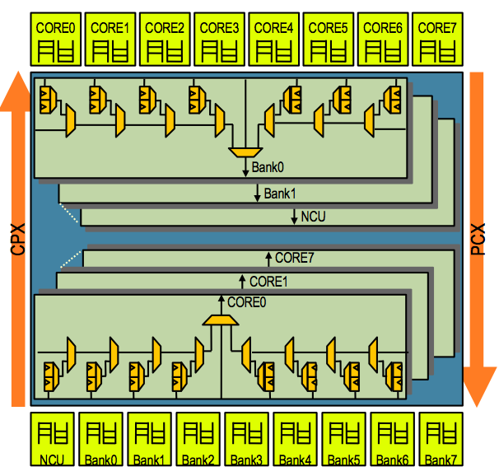
Sun UltraSPARC T2 Core-to-Cache Crossbar
High bandwidth interface between 8 cores and 8 L2 banks & NCU
4-stage pipeline: req, arbitration, selection, transmission
2-deep queue for each src/dest pair to hold data transfer request

Slide 27
Bufferless and Buffered Crossbars
0
+ Simpler arbitration/ scheduling
+ Efficient support for variable-size packets
- Requires N² buffers
0
NI
NI
Flow
Control
1
1
NI
NI
Flow
Control
2
2
NI
NI
Flow
Control
3
3
NI
NI
Flow
Control
Buffered
Crossbar
Output
Arbiter
Output
Arbiter
Output
Arbiter
Output
Arbiter
Bufferless
Crossbar

Slide 28
Can We Get Lower Cost than A Crossbar?
Yet still have low contention compared to a bus?
Idea: Multistage networks

Slide 29
Multistage Logarithmic Networks
Idea: Indirect networks with multiple layers of switches between terminals/nodes
Cost: O(NlogN), Latency: O(logN)
Many variations (Omega, Butterfly, Benes, Banyan, …)
Omega Network:
conflict

Slide 30
Multistage Networks (Circuit Switched)
0
0
A multistage network has more restrictions on feasible concurrent Tx-Rx pairs vs a crossbar
But more scalable than crossbar in cost, e.g., O(N logN) for Butterfly
1
1
2
2
3
3
4
4
5
5
6
6
7
7
2-by-2 crossbar

Slide 31
Multistage Networks (Packet Switched)
0
0
Packets “hop” from router to router, pending availability of the next-required switch and buffer
1
1
2
2
3
3
4
4
5
5
6
6
7
7
2-by-2 router

Slide 32
Aside: Circuit vs. Packet Switching
Circuit switching sets up full path before transmission
Establish route then send data
Noone else can use those links while “circuit” is set
+ faster arbitration
-- setting up and bringing down “path” takes time
Packet switching routes per packet in each router
Route each packet individually (possibly via different paths)
If link is free, any packet can use it
-- potentially slower --- must dynamically switch
+ no setup, bring down time
+ more flexible, does not underutilize links

Slide 33
Switching vs. Topology
Circuit/packet switching choice independent of topology
It is a higher-level protocol on how a message gets sent to a destination
However, some topologies are more amenable to circuit vs. packet switching

Slide 34
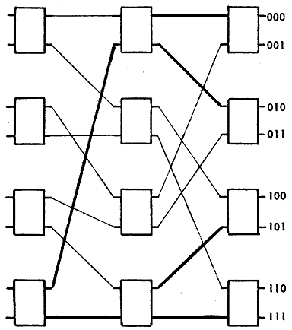
Another Example: Delta Network
Single path from source to destination
Each stage has different routers
Proposed to replace costly crossbars as processor-memory interconnect
Janak H. Patel ,“Processor-Memory Interconnections for Multiprocessors,” ISCA 1979.
8x8 Delta network

Slide 35
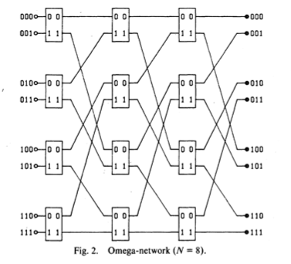
Another Example: Omega Network
Single path from source to destination
All stages are the same
Used in NYU Ultracomputer
Gottlieb et al. “The NYU Ultracomputer - Designing an MIMD Shared Memory Parallel Computer,” IEEE Trans. On Comp., 1983.

Slide 36
Ring
Each node connected to exactly two other nodes. Nodes form a continuous pathway such that packets can reach any node.
+ Cheap: O(N) cost
- High latency: O(N)
- Not easy to scale
- Bisection bandwidth remains constant
Used in Intel Haswell,
Intel Larrabee, IBM Cell,
many commercial systems today
Notes:
KSR machine, Hector

Slide 37
Unidirectional Ring
Single directional pathway
Simple topology and implementation
Reasonable performance if N and performance needs (bandwidth & latency) still moderately low
O(N) cost
N/2 average hops; latency depends on utilization
R
R
R
R
2x2 router
0
1
N-2
N-1
2

Slide 38
Bidirectional Rings
Multi-directional pathways, or multiple rings
+ Reduces latency
+ Improves scalability
- Slightly more complex injection policy (need to select which ring to inject a packet into)

Slide 39
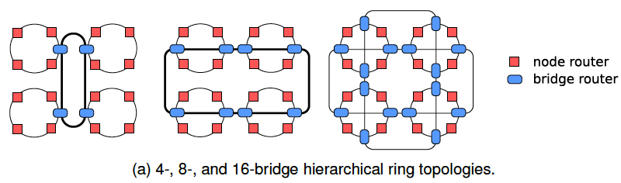
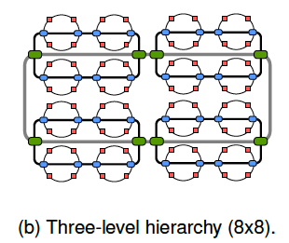
Hierarchical Rings
+ More scalable
+ Lower latency
- More complex

Slide 40
More on Hierarchical Rings
Rachata+, “Design and Evaluation of Hierarchical Rings with Deflection Routing,” SBAC-PAD 2014.
http://users.ece.cmu.edu/~omutlu/pub/hierarchical-rings-with-deflection_sbacpad14.pdf
Discusses the design and implementation of a mostly-bufferless hierarchical ring

Slide 41
Mesh
Each node connected to 4 neighbors (N, E, S, W)
O(N) cost
Average latency: O(sqrt(N))
Easy to layout on-chip: regular and equal-length links
Path diversity: many ways to get from one node to another
Used in Tilera 100-core
And many on-chip network
prototypes
Notes:
e.g. Tile64

Slide 42
Torus
Mesh is not symmetric on edges: performance very sensitive to placement of task on edge vs. middle
Torus avoids this problem
+ Higher path diversity (and bisection bandwidth) than mesh
- Higher cost
- Harder to lay out on-chip
- Unequal link lengths

Slide 43
Torus, continued
Weave nodes to make inter-node latencies ~constant

Slide 44
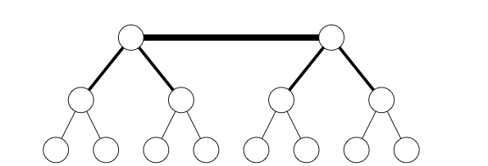
Trees
Planar, hierarchical topology
Latency: O(logN)
Good for local traffic
+ Cheap: O(N) cost
+ Easy to Layout
- Root can become a bottleneck
Fat trees avoid this problem (CM-5)
Fat Tree

Slide 45
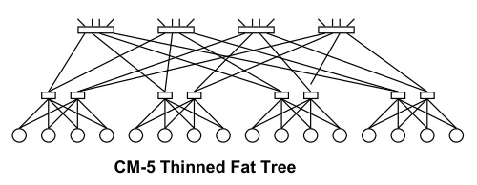
CM-5 Fat Tree
Fat tree based on 4x2 switches
Randomized routing on the way up
Combining, multicast, reduction operators supported in hardware
Thinking Machines Corp., “The Connection Machine CM-5 Technical Summary,” Jan. 1992.

Slide 46
Hypercube
“N-dimensional cube” or “N-cube”
Latency: O(logN)
Radix: O(logN)
#links: O(NlogN)
+ Low latency
- Hard to lay out in 2D/3D
1101
1111
1100
0101
0111
1110
0100
1001
1011
0110
1000
1010
0001
0011
0000
0010
Notes:
Popular in early message-passing computers (e.g., intel iPSC, NCUBE)

Slide 47
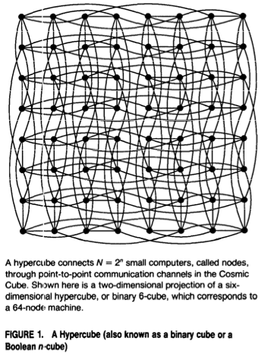
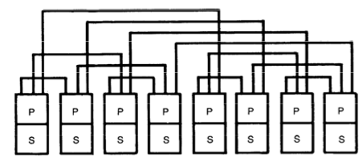
Caltech Cosmic Cube
64-node message passing machine
Seitz, “The Cosmic Cube,” CACM 1985.

Slide 48
Interconnection Network Basics
Topology
Specifies the way switches are wired
Affects routing, reliability, throughput, latency, building ease
Routing (algorithm)
How does a message get from source to destination
Static or adaptive
Buffering and Flow Control
What do we store within the network?
Entire packets, parts of packets, etc?
How do we throttle during oversubscription?
Tightly coupled with routing strategy

Slide 49
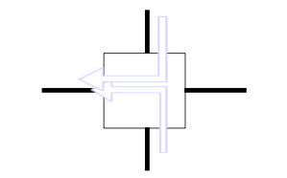
Handling Contention
Two packets trying to use the same link at the same time
What do you do?
Buffer one
Drop one
Misroute one (deflection)
Tradeoffs?

Slide 50
Bufferless Deflection Routing
Key idea: Packets are never buffered in the network. When two packets contend for the same link, one is deflected.¹
New traffic can be injected
whenever there is a free
output link.
Destination
¹Baran, “On Distributed Communication Networks.” RAND Tech. Report., 1962 / IEEE Trans.Comm., 1964.

Slide 51
Bufferless Deflection Routing
Input buffers are eliminated: packets are buffered in pipeline latches and on network links
Input Buffers
North
North
South
South
East
East
West
West
Local
Local
Deflection Routing Logic

Slide 52
Routing Algorithm
Three Types
Deterministic: always chooses the same path for a communicating source-destination pair
Oblivious: chooses different paths, without considering network state
Adaptive: can choose different paths, adapting to the state of the network
How to adapt
Local/global feedback
Minimal or non-minimal paths

Slide 53
Deterministic Routing
All packets between the same (source, dest) pair take the same path
Dimension-order routing
First traverse dimension X, then traverse dimension Y
E.g., XY routing (used in Cray T3D, and many on-chip networks)
+ Simple
+ Deadlock freedom (no cycles in resource allocation)
- Could lead to high contention
- Does not exploit path diversity

Slide 54
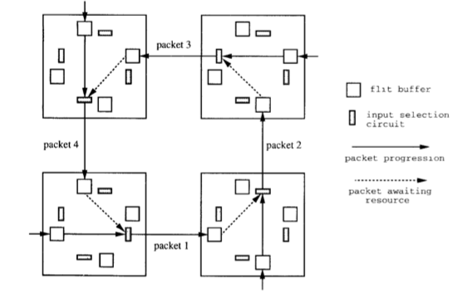
Deadlock
No forward progress
Caused by circular dependencies on resources
Each packet waits for a buffer occupied by another packet downstream

Slide 55
Handling Deadlock
Avoid cycles in routing
Dimension order routing
Cannot build a circular dependency
Restrict the “turns” each packet can take
Avoid deadlock by adding more buffering (escape paths)
Detect and break deadlock
Preemption of buffers

Slide 56
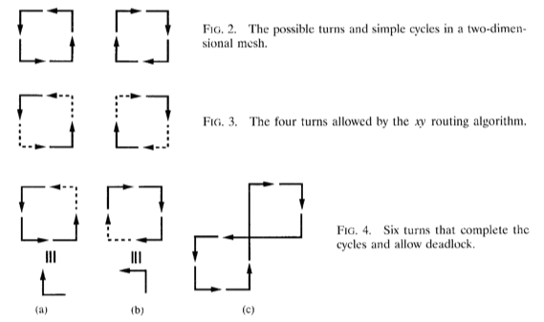
Turn Model to Avoid Deadlock
Idea
Analyze directions in which packets can turn in the network
Determine the cycles that such turns can form
Prohibit just enough turns to break possible cycles
Glass and Ni, “The Turn Model for Adaptive Routing,” ISCA 1992.

Slide 57
Oblivious Routing: Valiant’s Algorithm
An example of oblivious algorithm
Goal: Balance network load
Idea: Randomly choose an intermediate destination, route to it first, then route from there to destination
Between source-intermediate and intermediate-dest, can use dimension order routing
+ Randomizes/balances network load
- Non minimal (packet latency can increase)
Optimizations:
Do this on high load
Restrict the intermediate node to be close (in the same quadrant)

Slide 58
Adaptive Routing
Minimal adaptive
Router uses network state (e.g., downstream buffer occupancy) to pick which “productive” output port to send a packet to
Productive output port: port that gets the packet closer to its destination
+ Aware of local congestion
- Minimality restricts achievable link utilization (load balance)
Non-minimal (fully) adaptive
“Misroute” packets to non-productive output ports based on network state
+ Can achieve better network utilization and load balance
- Need to guarantee livelock freedom

Slide 59
On-Chip Networks
Connect cores, caches, memory controllers, etc
Buses and crossbars are not scalable
Packet switched
2D mesh: Most commonly used topology
Primarily serve cache misses and memory requests
PE
PE
PE
R
R
R
PE
PE
PE
R
R
R
PE
PE
PE
R
R
R
R
Router
Processing Element
(Cores, L2 Banks, Memory Controllers, etc)
PE
Notes:
One commonly proposed solution is on-chip network (NoC), which allows cores to communicate with a packet switched substrate.
Here is a figure showing an on-chip network that uses a 2d-mesh topology which
is commonly used due to its low layout complexity.
This is also the topology we used for our evaluations, but our mechanism is also applicable to other topologies.
In most multi-core systems, NoC primarily serves cache misses and memory requests.

